Slide 1
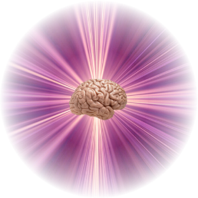
Associative Data Model in Search for Nearest Neighbors and Similar Patterns
Adrian Horzyk
horzyk@agh.edu.pl
Google: Horzyk
Janusz A. Starzyk
starzykj@ohio.edu
Google: Janusz Starzyk
AGH University of
Science and Technology
Krakow, Poland
Ohio University, Athens, Ohio, U.S.A., School of Electrical Engineering and Computer Science
University of Information Technology and Management, Rzeszow, Poland

Slide 2
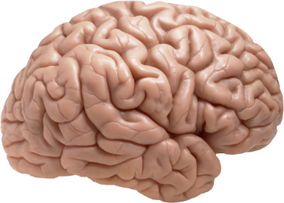
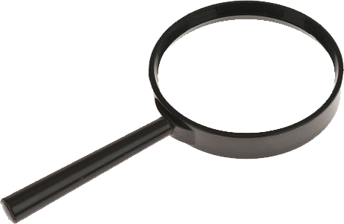
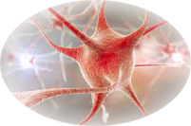
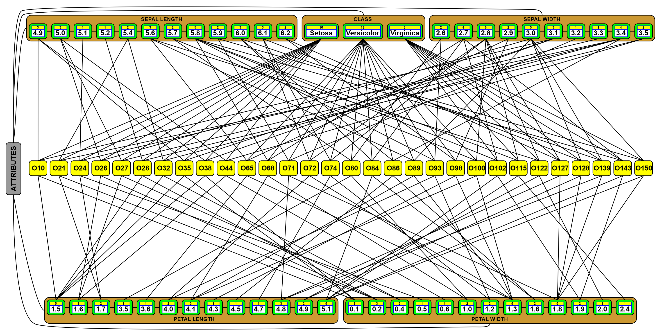
Inspiration and Objectives
Creation of the efficient nearest neighbors and similar pattern search algorithms based on the brain-like structure and associative processes.

Slide 3
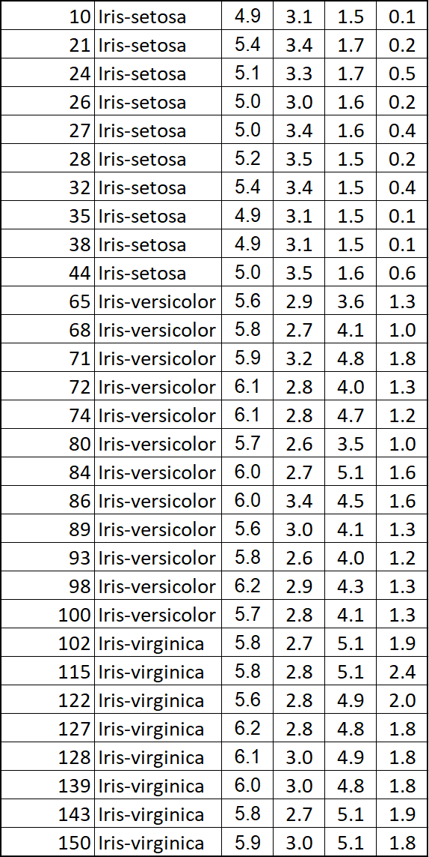
Disadvantages of Tabular Structures
Tabular structures do not relate objects vertically, so many relations between stored objects must be discovered during time-taking searches through them:
Let’s have a table of data:
What we can say about the stored data in this table?
Which objects are the most similar or different?
Can we order them simply?
Can we quickly point out the most similar objects to the given one, e.g. to the object “93”?
What will we have to do to find similarities, differences, minima, maxima, groups, clusters, …?
How much time it takes when we have huge amount of data stored in such tables?
?

Slide 4
Benefits of Associative Graph Structures
Associative graph structures cannot only relate objects horizontally and vertically, but they can also represent any kind of association between objects what simplifies and accelerates all search processes:
What is the difference and where are advantages in associative graph data representation?

Slide 5
Benefits of Associative Graph Structures
All data are sorted simultaneously for all attributes!
So we don’t need to sort data any more before searching through them.
What’s more?

Slide 6
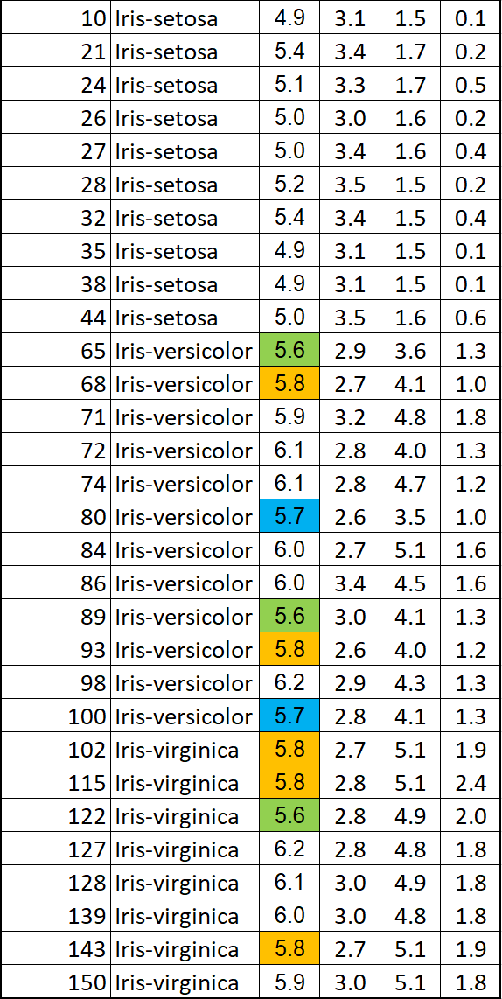
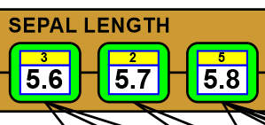
Benefits of Associative Graph Structures
All duplicates of the data of all attributes separately are aggregated and counted!
So we don’t need to search for duplicates, number of unique values or count up how many different values and how many duplicates of each value we have.
What’s more?

Slide 7
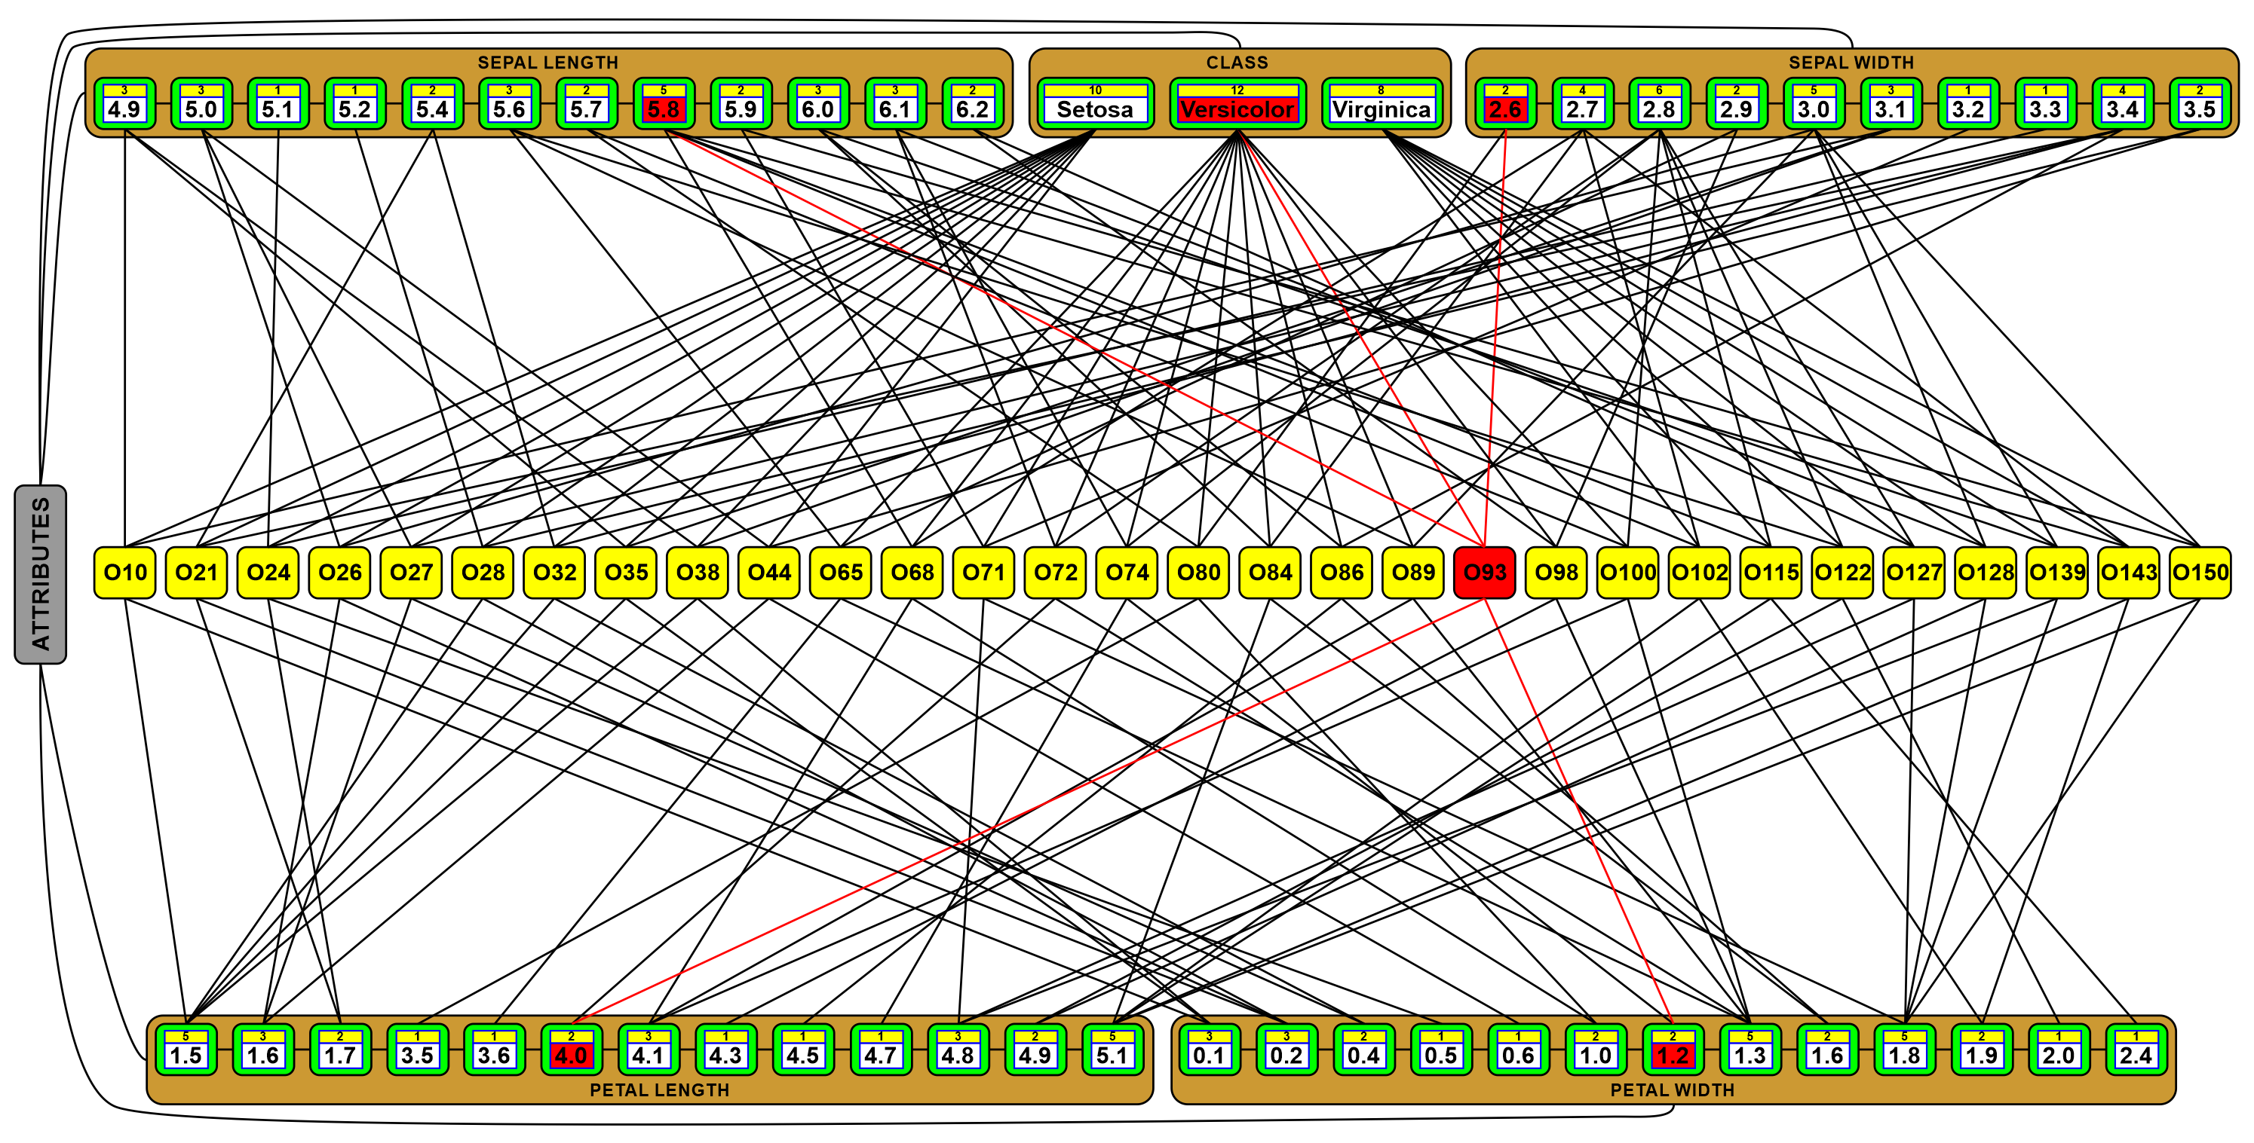
Benefits of Associative Graph Structures
Defining or defined objects can be quickly found thanks to direct connections between defining and defined objects, as well as other interrelated objects connected by the indirect connections.
What’s more?

Slide 8
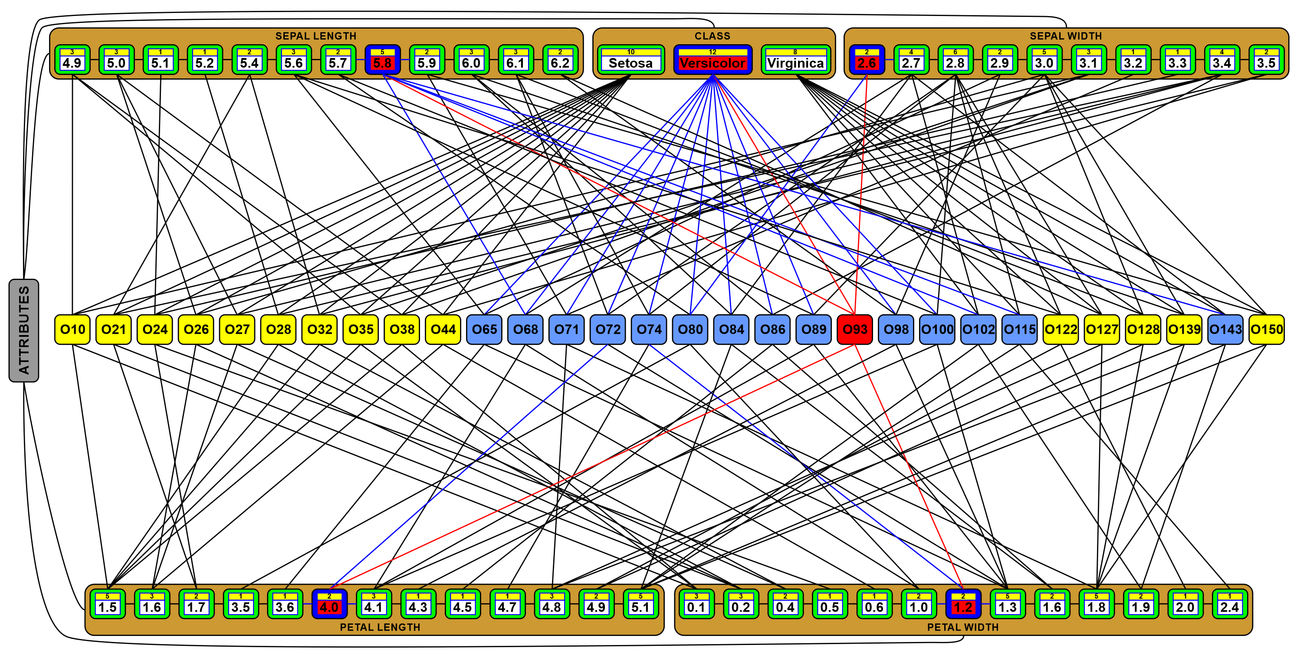
Benefits of Associative Graph Structures
Other objects defined by the same values or objects can also be quickly found thanks to the aggregated representation of the same values and objects in these associative graph structures.
What’s more?

Slide 9
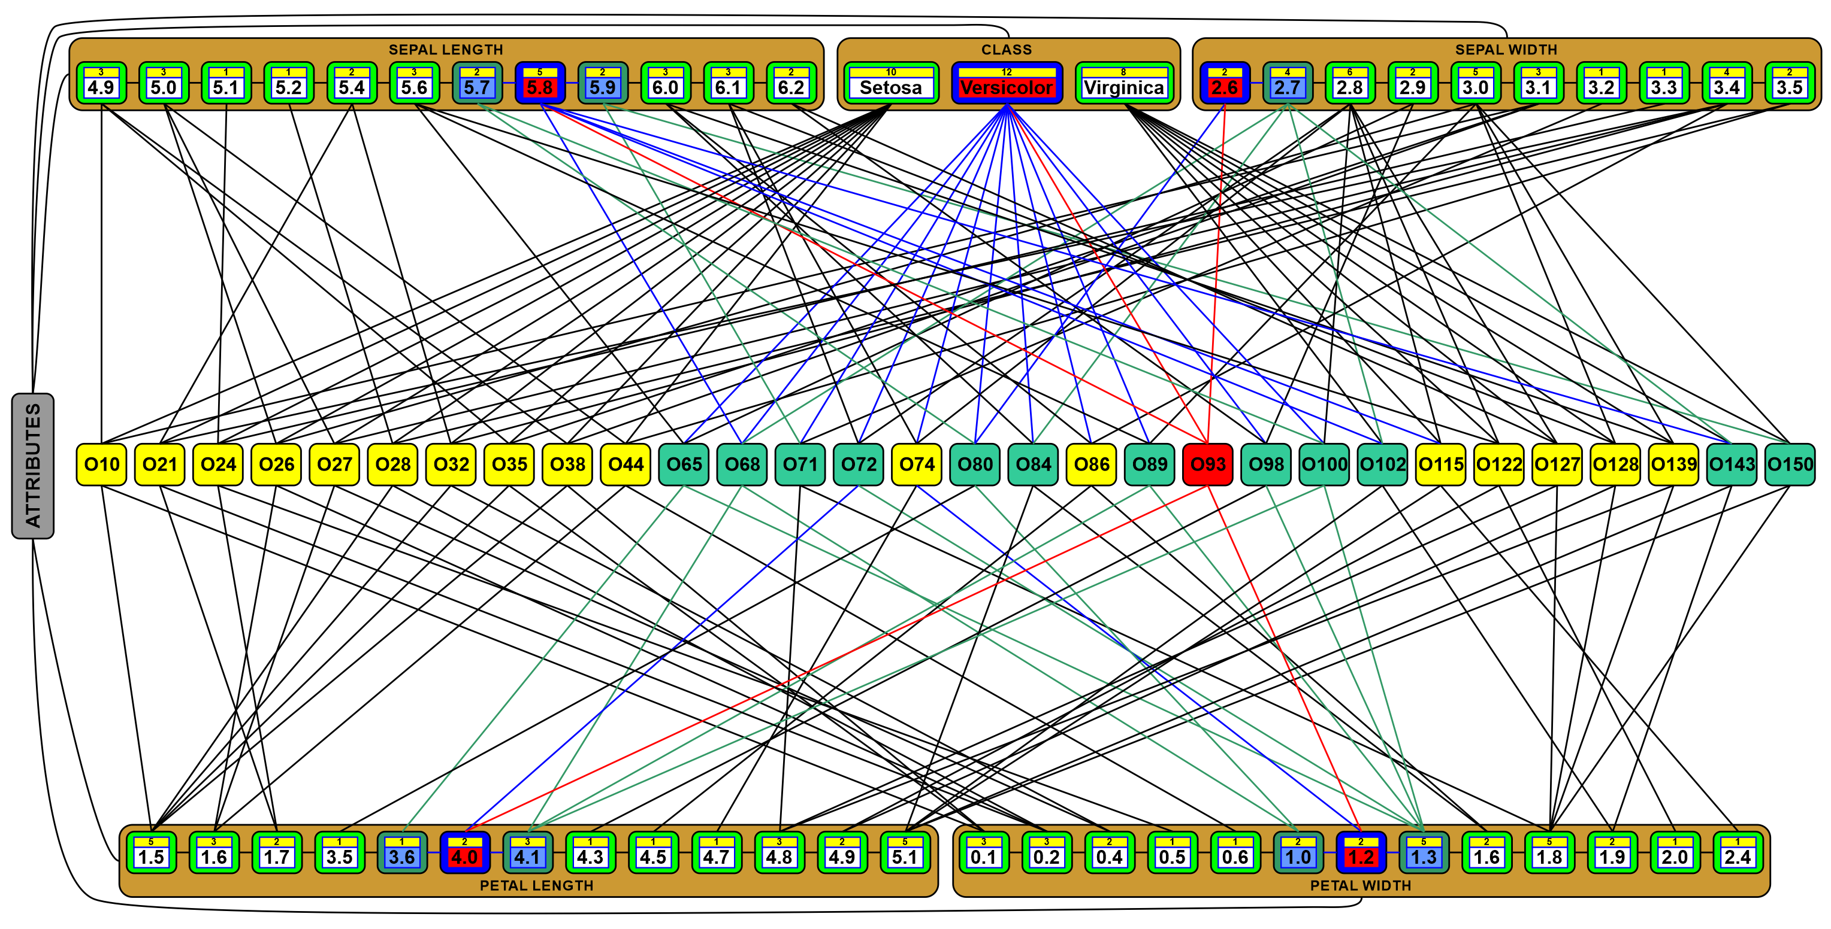
Benefits of Associative Graph Structures
Other similar objects defined by the similar values can be also quickly found thanks to the storing all attribute data in sorted order and the connections to the nearest (neighbour) values in these orders.
What’s more?

Slide 10
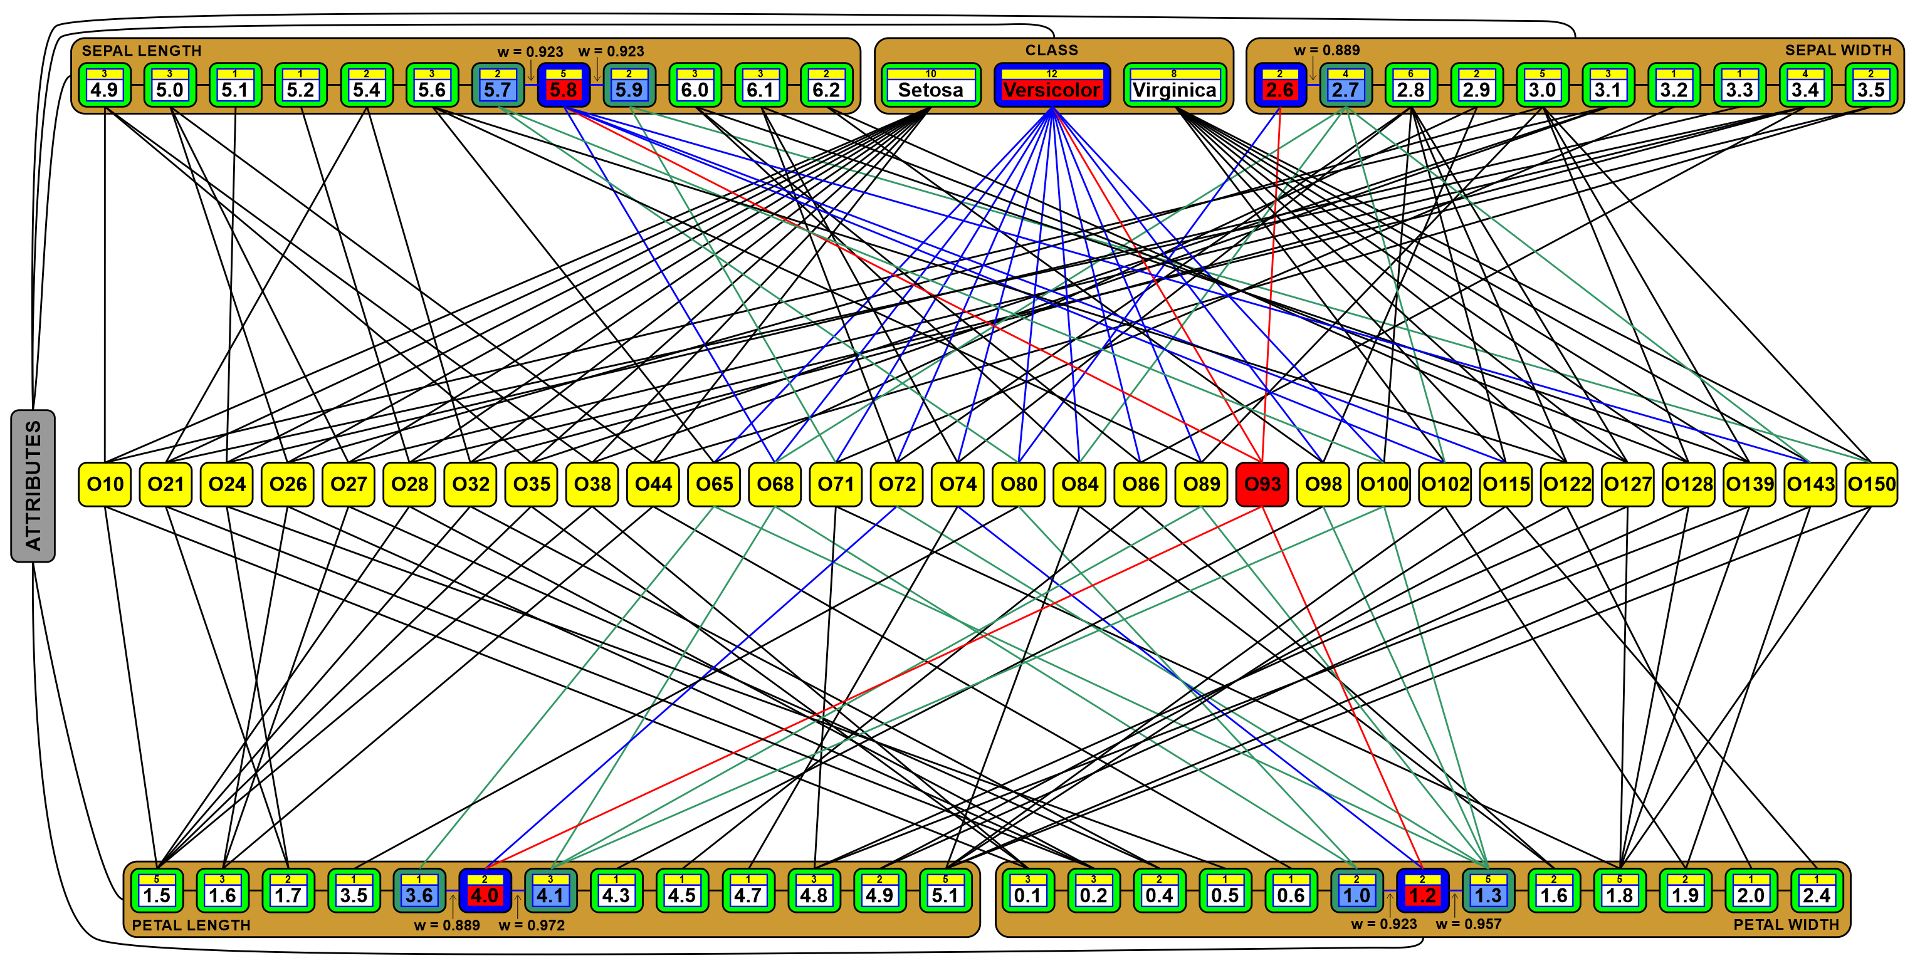
Benefits of Associative Graph Structures
All connections are weighted, so there is not only a binary representation of relations but also the ability to express the different strengths of associations between represented data and objects, evaluating values of data relations.
What’s more?

Slide 11
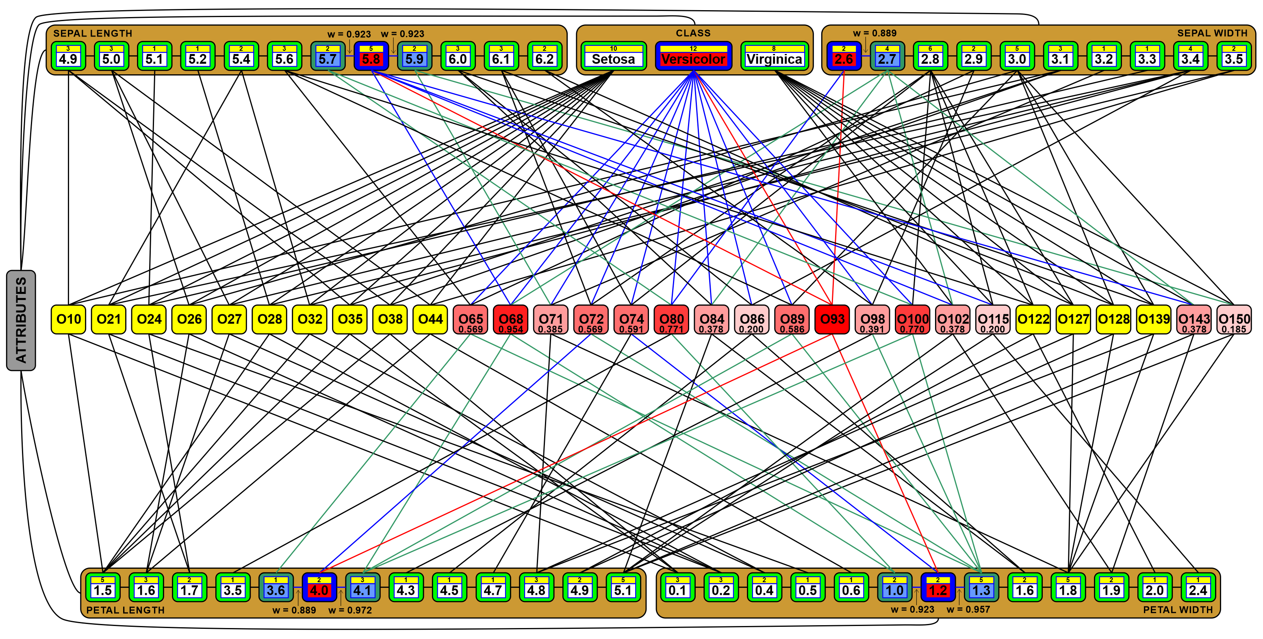
Benefits of Associative Graph Structures
Associative strengths between represented objects can be quickly computed thanks to the weighted connections between nodes representing defining data and objects on all closest paths between such objects.
We can search for the strongest associated objects only in the close surroundings.

Slide 12
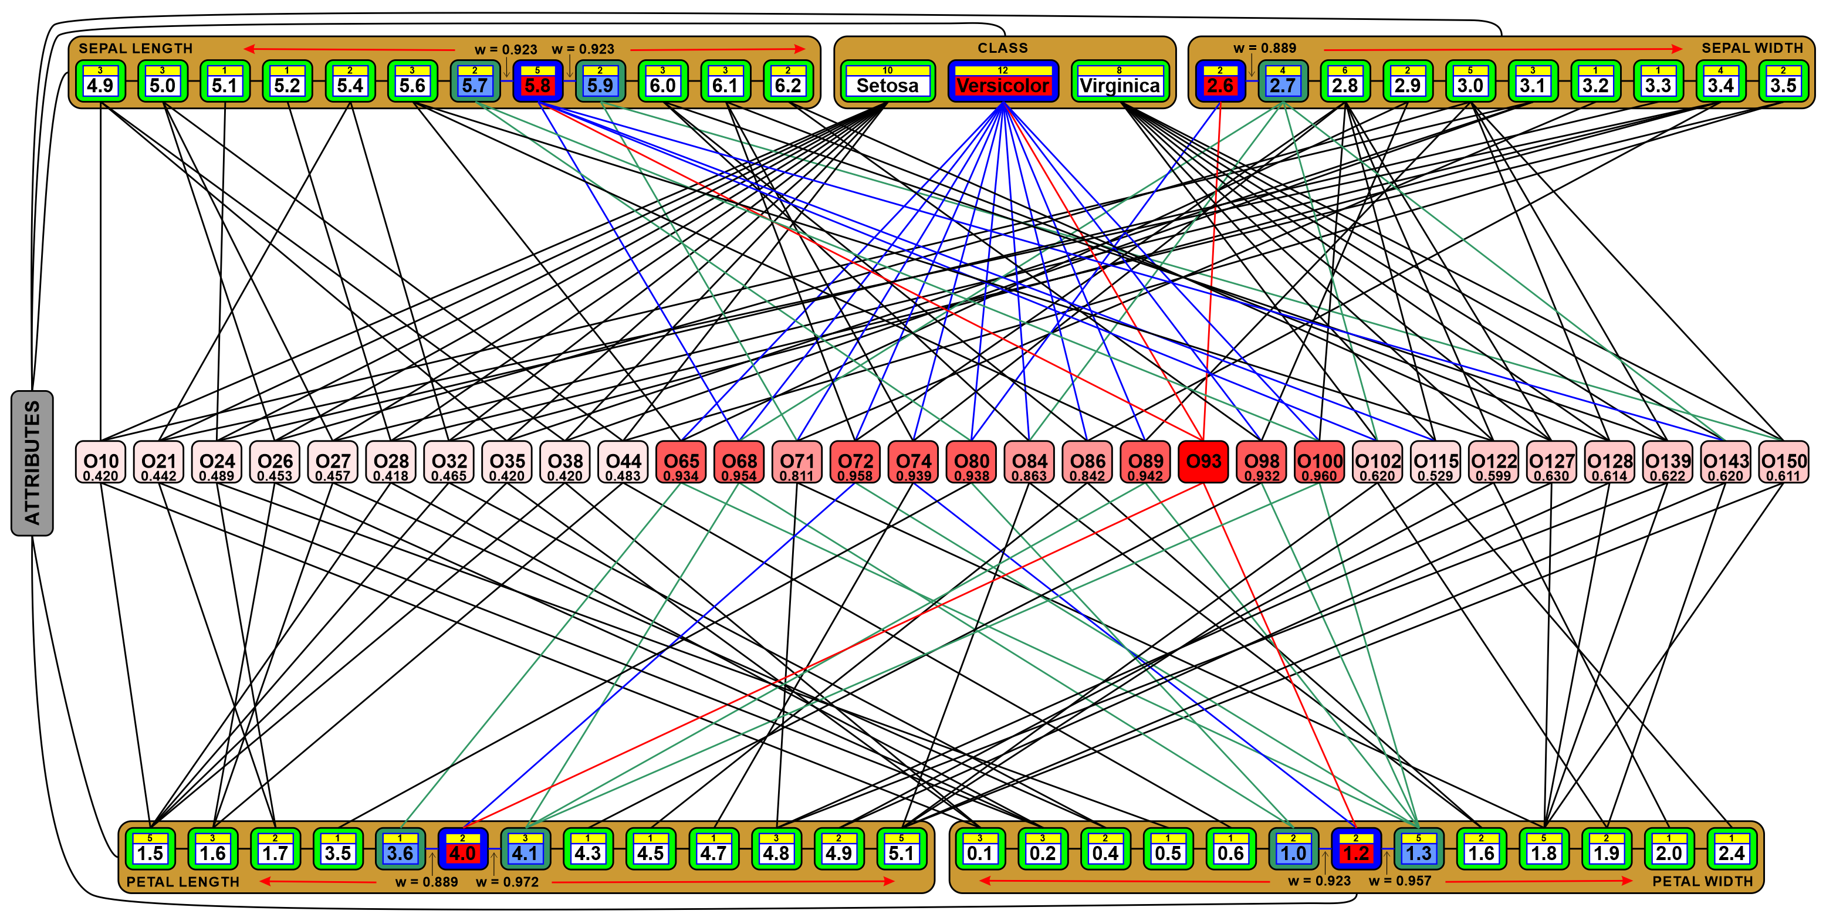
Benefits of Associative Graph Structures
Associative strengths (here similarity) between all objects connected to the given one (here 93) can also be computed using weighted connections between nodes representing defining data and objects on all paths between such objects.
We can search for the associated objects in the whole surroundings.

Slide 13
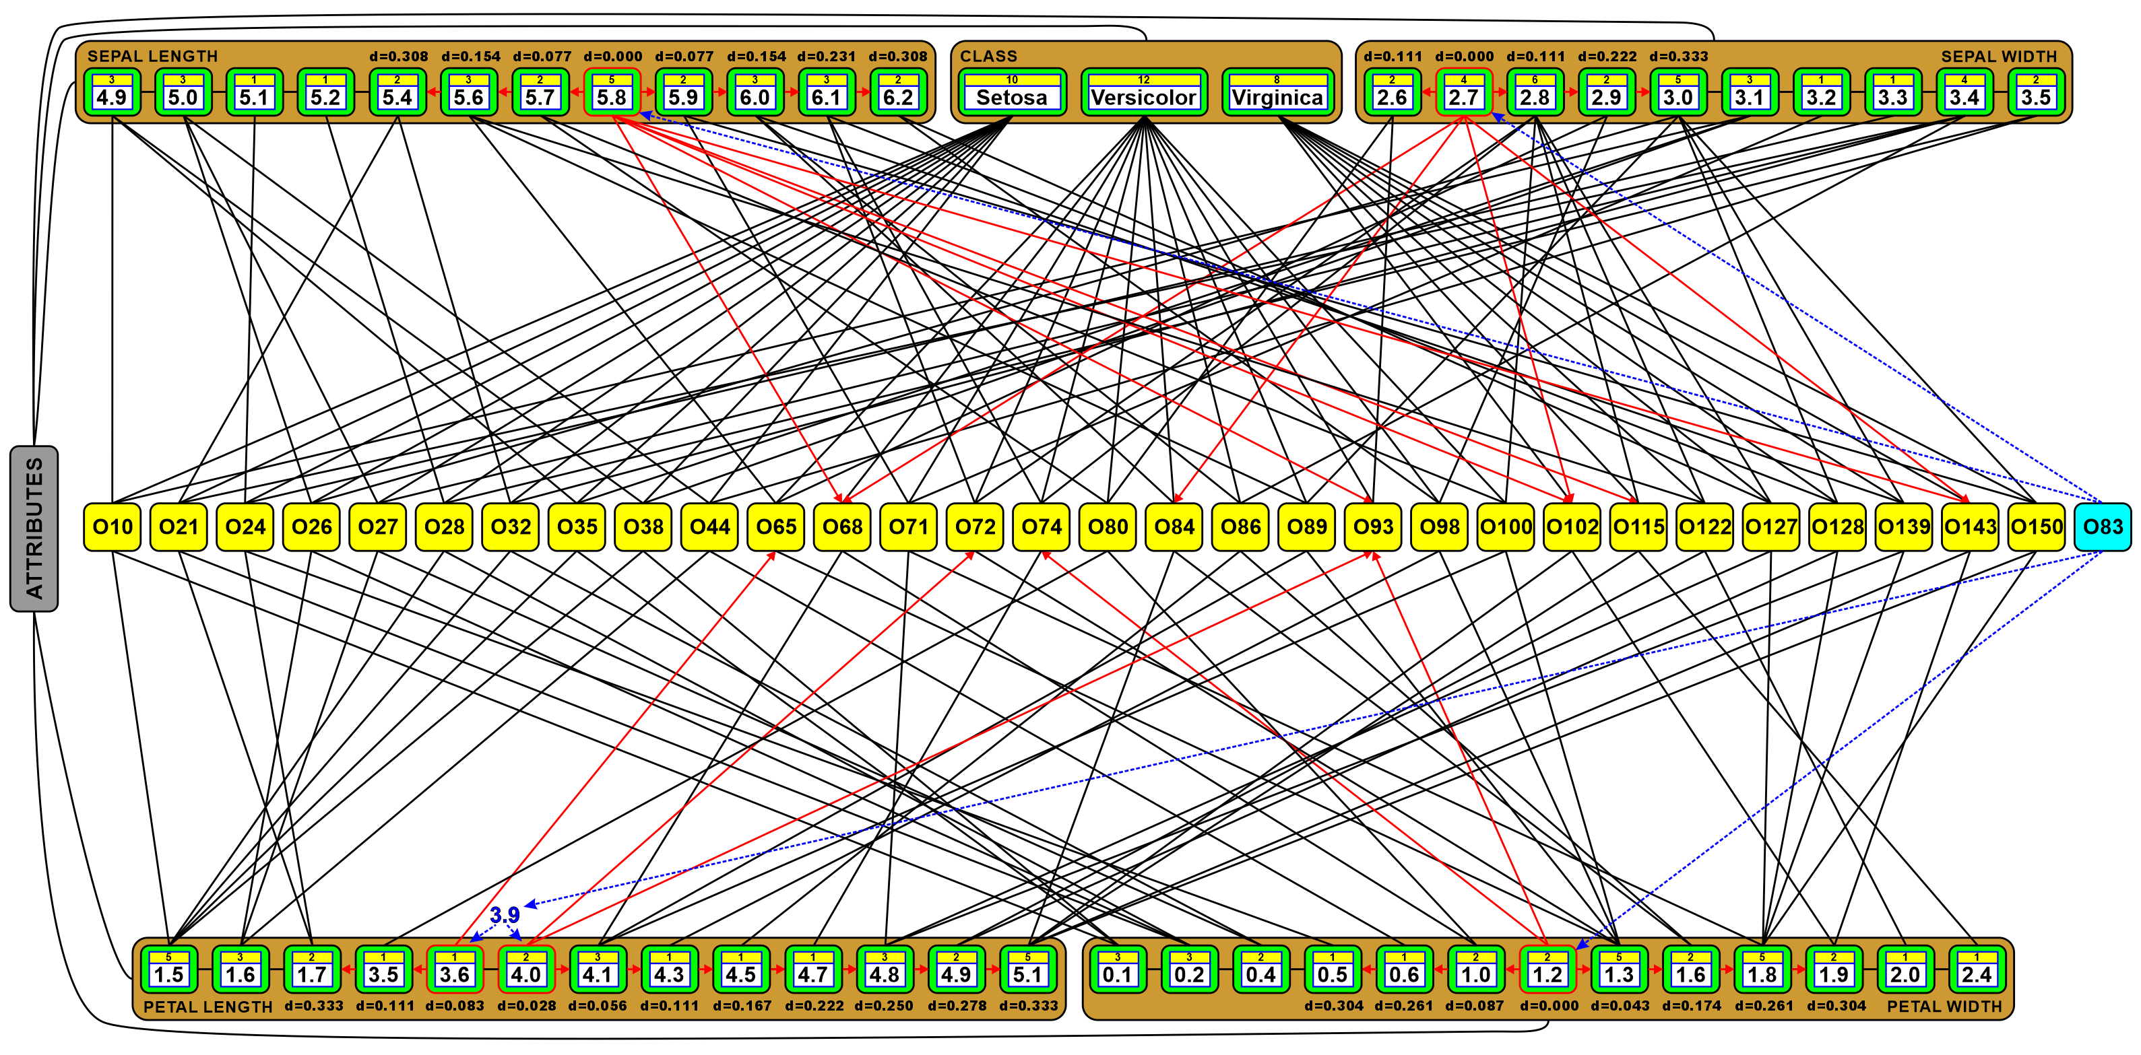
Search for the Nearest Neighbors
Associative Graph Data Structures (AGDS) can be easily adapted to quickly compute Euclidean, Manhattan, or Sebestyen distances between close objects indirectly connected by the strong enough weights in the closest surroundings until we find k nearest neighbors and are sure that all others are more distant.
In this concept, we don’t need to look through all data as in the KNN search algorithm.

Slide 14
Associative Search for Nearest Neighbors
The three proposed algorithms start from the nodes representing values that have the smallest, normalized distances to the values defining the classified object.
Next, they go along the edges to the connected object nodes to compute object distances.
The computed distances are used to sort objects in a rank table or a rank list.
According to the proposed algorithm, the distances are computed at once or partially.

Slide 15
Associative Search for Nearest Neighbors
We take into account a single or a few most variant attributes, e.g. petal length (PL) and/or petal width (PW) in the example below because both are defined by 13 unique values. The closest values are: PW.1.2 (d=0.000), PL.4.0 (d=0.028), PW.1.3 (d=0.043), PL.4.1 (d=0.056), PL.3.6 (d=0.083), PW.1.0 (d=0.087), PL.3.5 (d=0.111), PL.4.3 (d=0.111), PW.1.6 (d=0.174), etc.
From the closest values, we get into the objects O74, O93, O72, … to compute object distances.

Slide 16
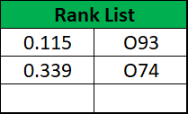
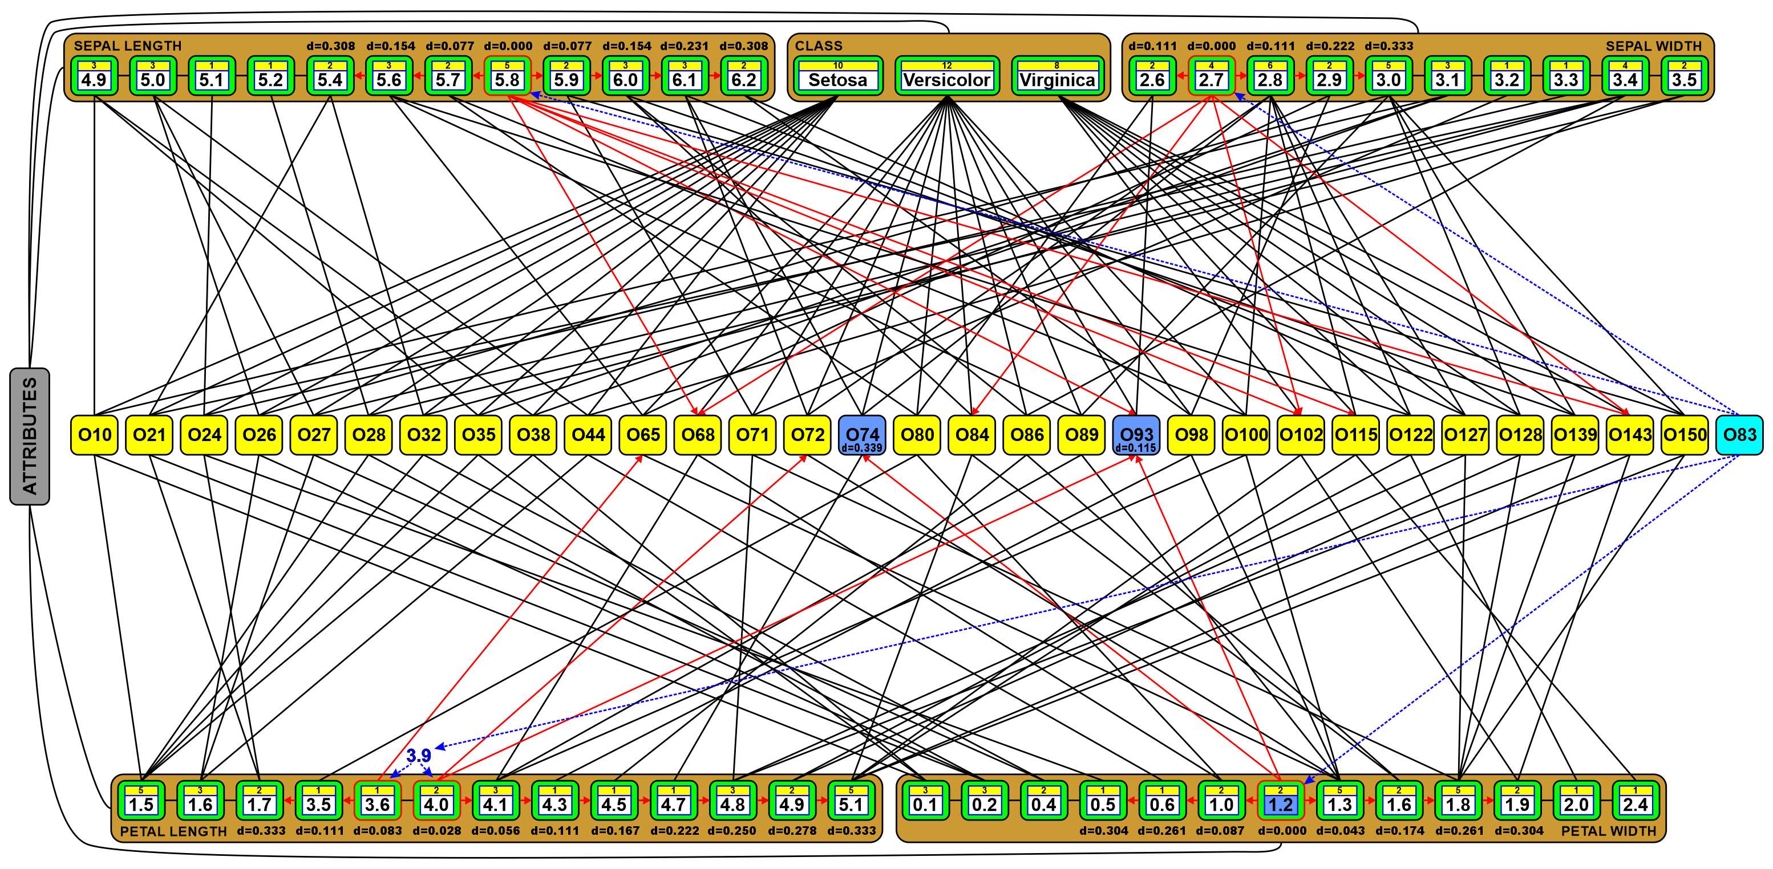
Associative Search for Nearest Neighbors
Let’s look for 3 nearest neighbors (the most similar objects) to the O83 = [5.8, 2.7, 3.9, 1.2].
1. Start from the closest value PW.1.2 (d=0.000) and compute Euclidean distances for connected objects O74 (d=0.339) and O93 (d=0.115), and insert them into the rank list that was empty because we just started this algorithm, so the values are added in sorted order:
This rank list is 3-element long because we are searching for 3 nearest neighbors.
When this list will be full the elements will be replaced to leave there the nearest.

Slide 17
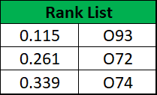
Associative Search for Nearest Neighbors
2. Move to the next closest value from the selected subset of the most variant attributes PL.4.0 (d=0.028) and compute Euclidean distances for connected objects O72 (d=0.261) to which distances were not yet computed (for O93 the distance was already computed), and insert them into the rank list in sorted order. After this step, the rank list has 3-element but the algorithms will continue the search for nearest neighbors until the distance to the next value is longer than the most distant object of this rank list.

Slide 18
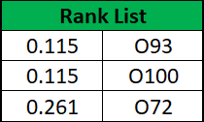
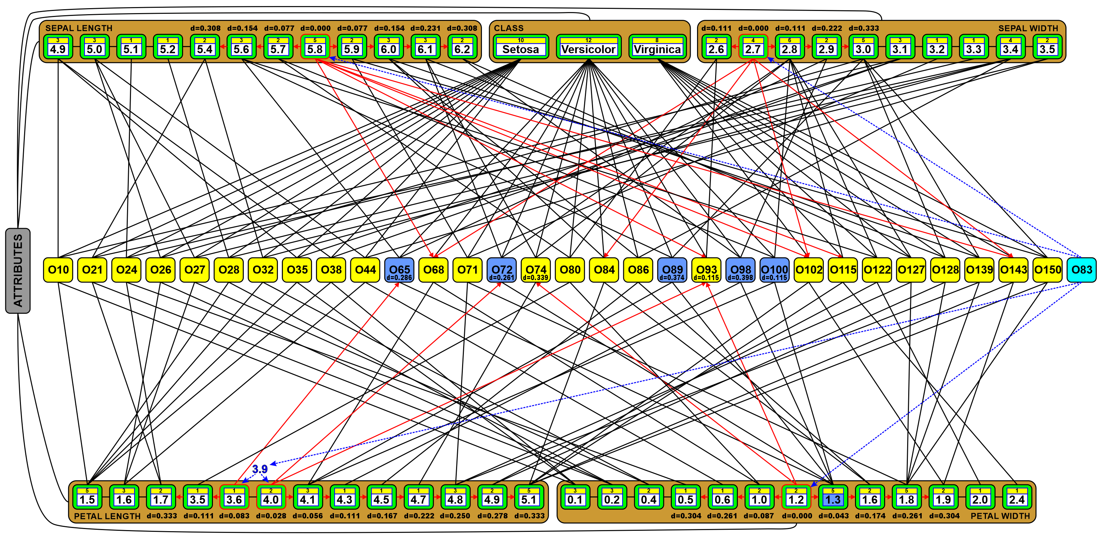
Associative Search for Nearest Neighbors
3. Move to the next closest value from the selected subset of the most variant attributes PW.1.3 (d=0.043) and compute Euclidean distances for connected objects O65 (d=0.286), O89 (d=0.374), O98 (d=0.398), and O100 (d=0.115) to which distances were not yet computed, insert them into the rank list in sorted order, and remove the most distant objects. The most distant object O72 has its distance still bigger than the distance to the next closest attribute value, so the search for 3 nearest neighbors is continued.

Slide 19
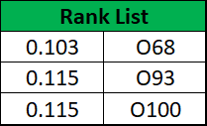
Associative Search for Nearest Neighbors
4. Move to the next closest value from the selected subset of the most variant attributes PL.4.1 (d=0.056) and compute Euclidean distances for connected objects O68 (d=0.103) to which the distance were not yet computed, and insert them into the rank list in sorted order. After this step, we already have 3 nearest neighbors, but the algorithm must run for a few steps more because the stop condition is not yet satisfied, so theoretically there might be some other objects which could be closer.

Slide 20
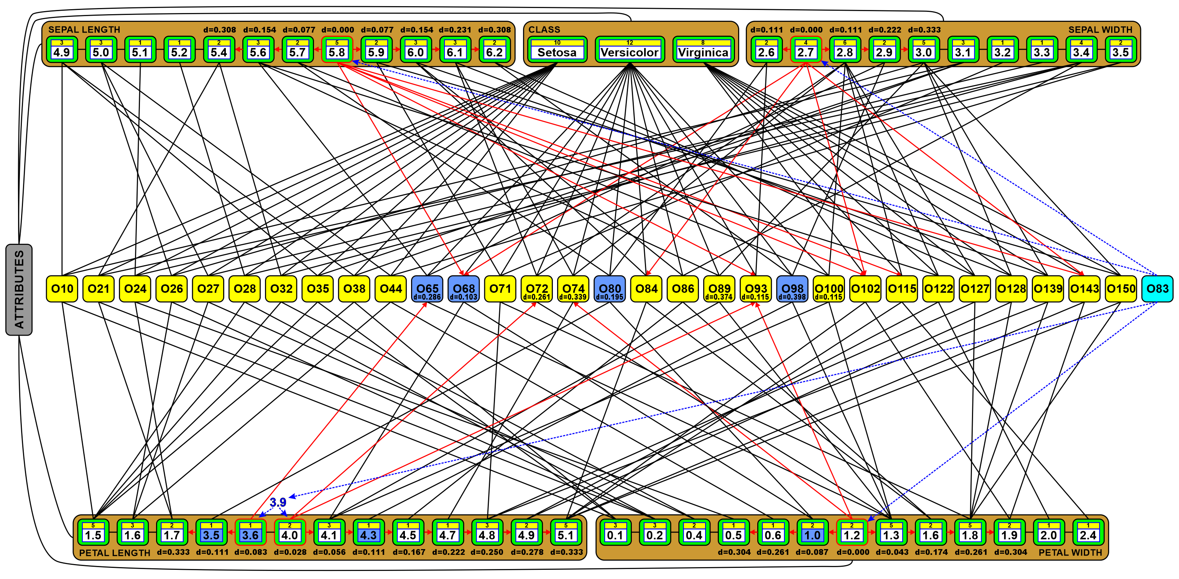
Associative Search for Nearest Neighbors
5. Move to the next closest values from the selected subset of the most variant attributes PL.3.6 (d=0.083), PW.1.0 (d=0.087), PL.3.5 (d=0.111), PL.4.3 (d=0.111) and compute Euclidean distances for connected objects O80 (d=0.195) to which the distance were not yet computed, and insert them into the rank list in sorted order. The rank list does not change during these four steps any more. Finally, the stop condition has been satisfied and the algorithm stops finding 3 nearest neighbors: O68, O93, and O100.

Slide 21
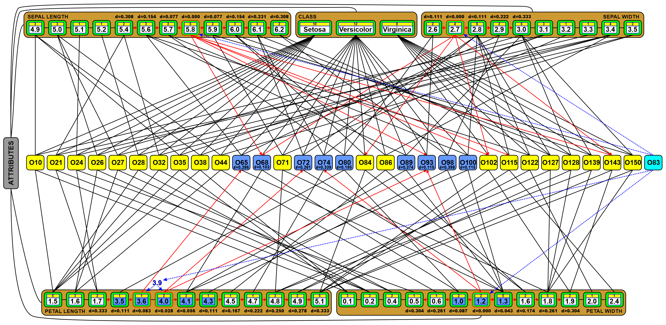
Associative Search for Nearest Neighbors
Conclusion. As could be noticed, the algorithm required to go through 8 closest attribute values connected to 9 objects from 30 objects in this object set. So we have saved time for the computation of 21 Euclidean distances thanks to the use of the associative graph structures.
This simple example is not representative for huge datasets, where the savings are much bigger, but it illustrates the use of one of the associative search algorithm presented in the accompanying paper that describe three sophisticated algorithms optimizing various aspects of such searches.

Slide 22
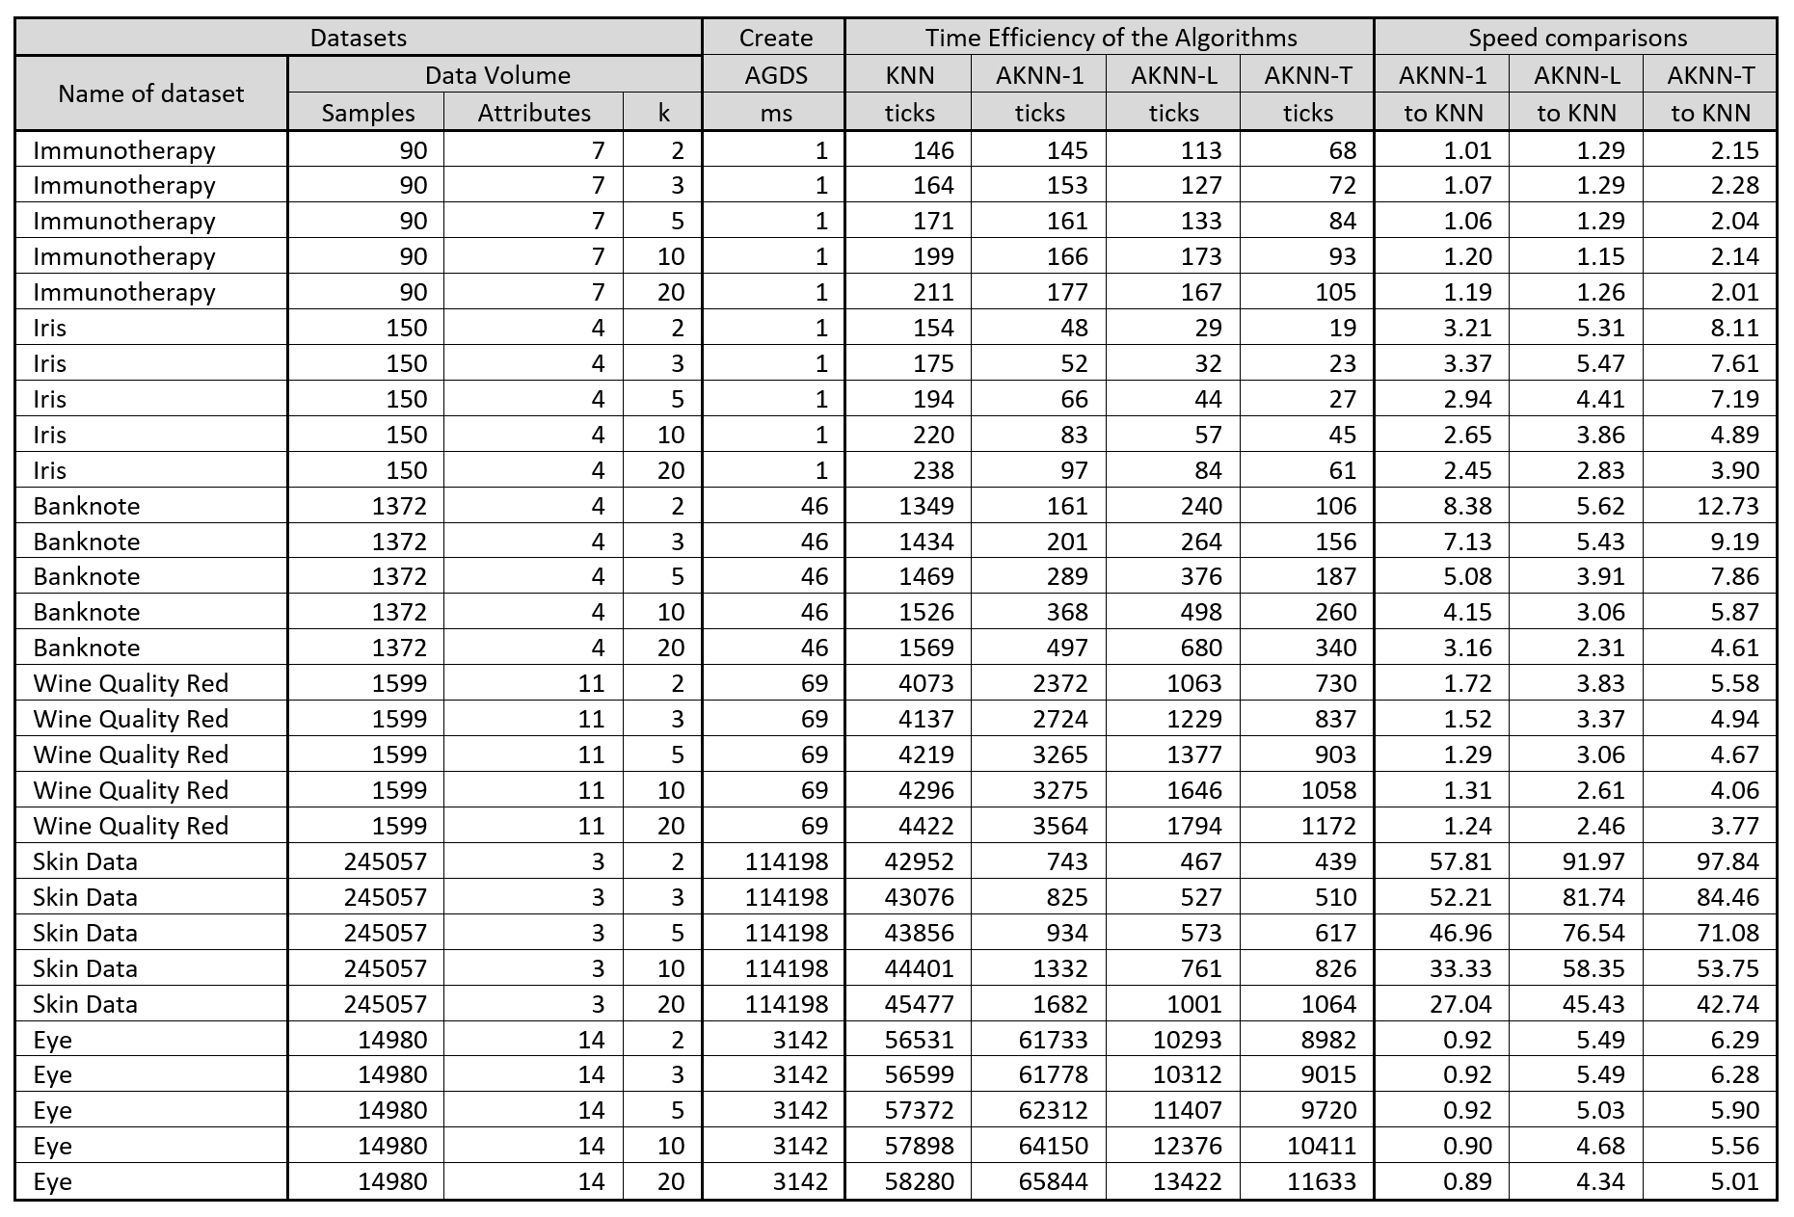
Experimental Results and Comparisons
How much faster it is :

Slide 23
Experimental Results and Comparisons
Improvement of the classification performance
Conclusion:
Taking various attributes with various priorities improves the total performance of the classifier.

Slide 24
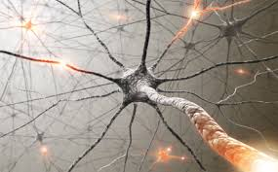
Conclusion and Remarks
Associative Graph Data Structures (AGDS) together with the associative search approaches allowed to find k Nearest Neighbors faster than the classic algorithm.
Associative Graph Structures represent many more data relationships, which makes some algorithms working faster, simplifying search effort and saving time.

Slide 25
Future Research of Associative Graphs
Representation of any data and relationships in one efficiently managed graph.
Fast processing of vectorized data of any type: classic, sequential or structured.
Representation of semantic memories and various data dependencies.
Representation of knowledge in the cognitive systems.
Combining with other deep neural network architectures to learn and represent more complex dependencies and use them in various computational tasks.

Slide 26
Questions or Remarks?
Basawaraj, J. A. Starzyk, A. Horzyk, Episodic Memory in Minicolumn Associative Knowledge Graphs, IEEE Transactions on Neural Networks and Learning Systems, Vol. 30, Issue 11, 2019, pp. 3505-3516, DOI: 10.1109/TNNLS.2019.2927106 (TNNLS-2018-P-9932), IF = 7.982.
J. A. Starzyk, Ł. Maciura, A. Horzyk, Associative Memories with Synaptic Delays, IEEE Transactions on Neural Networks and Learning Systems, Vol. .., Issue .., 2019, pp. ... - ..., DOI: 10.1109/TNNLS.2019.2921143 (TNNLS-2018-P-9188), IF = 7.982.
A. Horzyk, K. Gołdon, and J.A. Starzyk, Temporal Coding of Neural Stimuli, In: 28th International Conference on Artificial Neural Networks (ICANN 2019), Springer-Verlag, LNCS 11731, pp. 607-621, 2019, DOI: 10.1007/978-3-030-30493-5_56A. Horzyk, J. A. Starzyk, J. Graham, Integration of Semantic and Episodic Memories, IEEE Transactions on Neural Networks and Learning Systems, Vol. 28, Issue 12, Dec. 2017, pp. 3084 - 3095, 2017, DOI: 10.1109/TNNLS.2017.2728203.
A. Horzyk, J.A. Starzyk, Fast Neural Network Adaptation with Associative Pulsing Neurons, IEEE Xplore, In: 2017 IEEE Symposium Series on Computational Intelligence, pp. 339 -346, 2017, DOI: 10.1109/SSCI.2017.8285369.
A. Horzyk, Deep Associative Semantic Neural Graphs for Knowledge Representation and Fast Data Exploration, Proc. of KEOD 2017, SCITEPRESS Digital Library, pp. 67 - 79, 2017, DOI: 10.13140/RG.2.2.30881.92005.
A. Horzyk, Neurons Can Sort Data Efficiently, Proc. of ICAISC 2017, Springer-Verlag, LNAI, 2017, pp. 64 - 74, ICAISC BEST PAPER AWARD 2017 sponsored by Springer.
A. Horzyk, J. A. Starzyk and Basawaraj, Emergent creativity in declarative memories, IEEE Xplore, In: 2016 IEEE Symposium Series on Computational Intelligence, Greece, Athens: Institute of Electrical and Electronics Engineers, Curran Associates, Inc. 57 Morehouse Lane Red Hook, NY 12571 USA, 2016, ISBN 978-1-5090-4239-5, pp. 1 - 8, DOI: 10.1109/SSCI.2016.7850029.
Horzyk, A., How Does Generalization and Creativity Come into Being in Neural Associative Systems and How Does It Form Human-Like Knowledge?, Elsevier, Neurocomputing, Vol. 144, 2014, pp. 238 - 257, DOI: 10.1016/j.neucom.2014.04.046.
A. Horzyk, Innovative Types and Abilities of Neural Networks Based on Associative Mechanisms and a New Associative Model of Neurons - Invited talk at ICAISC 2015, Springer-Verlag, LNAI 9119, 2015, pp. 26 - 38, DOI 10.1007/978-3-319-19324-3_3.
A. Horzyk, Human-Like Knowledge Engineering, Generalization and Creativity in Artificial Neural Associative Systems, Springer-Verlag, AISC 11156, ISSN 2194-5357, ISBN 978-3-319-19089-1, ISBN 978-3-319-19090-7 (eBook), Springer, Switzerland, 2016, pp. 39 – 51, DOI 10.1007/978-3-319-19090-7.
Adrian Horzyk
horzyk@agh.edu.pl
Google: Horzyk
Janusz A. Starzyk
starzykj@ohio.edu
Google: Janusz Starzyk
University of Science and Technology in Krakow, Poland
Athens, OH, U.S.A.

